Slide 1
Social Performance Task Force
Financial a-
Social 4
Contributions to the Community
Evelyn Marilys Di Chiara Flores
Director of Planning and Project Development
Panama 2013

Slide 2
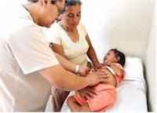
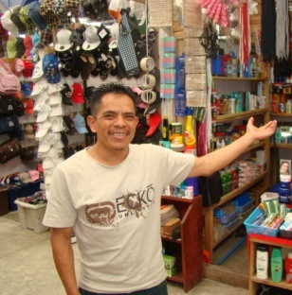
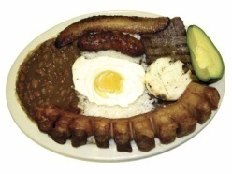
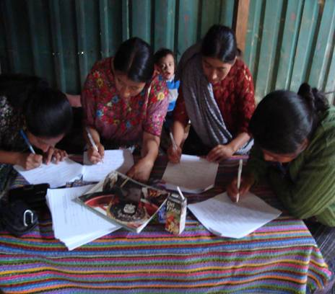
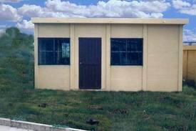
Strategic focus
DirecTORS and general Manager
CLIENT
GÉNESIS SUPPORT
INVESTMENT IN BUSINESS
HIGHER INCOME
BETTER LIFE QUALITY
Production
Agriculture
Commerce
Services
Housing
CRÉDIT
13,600
Clients/month
US$629
Avg. Loan
US$.34M.
162,042
Active clients
Data April 2013
14,979
Clients/month
Enterprise Dev. Services
TRAINING & TA.
PARTNERSHIPS
MANAGING Social Performance…

Slide 3
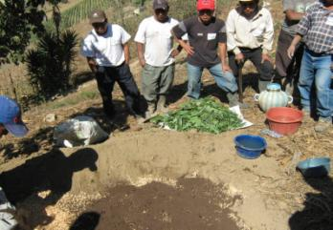
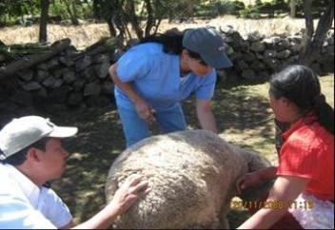
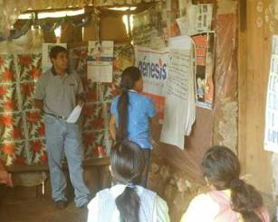
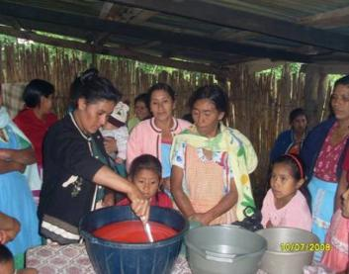
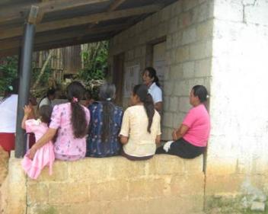
training and TA
90% Rural
65% Women
62% Indigenous
Técnico Agropecuaria
Farming and Livestock Techniques
Administrativa
Administrative
Alliances “Service Week”
Techniques for Productivity, Social, &
Environmental Topics
42% No education
47% Incomplete primary education
Over 130 technical development courses available

Slide 4
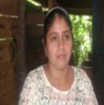
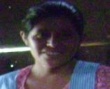
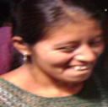
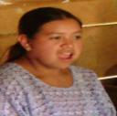
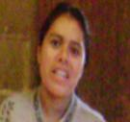
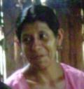
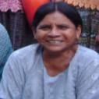
Fundation GÉNESIS EMPRESARIAL Understanding clients’ needs & preferences
Systems for
Market Research and Customer Service

Slide 5
PROCESS: customer sATISFACion Responding to THE target clients’ needs

Slide 6
DESCOVERING clients’ needs
Market Studies: Clients and Partners

Slide 7
Addressing Target Clients’ Needs
2. Key inputs to improve customer service and client satisfaction
Recently set up client service unit to monitor client opinions on an on-going basis and promote on-going change and continuous improvement ...

Slide 8
Addressing Target Clients’ Needs
Banner on
Client Protection Principles
Pilot Activities on
Customer Service
Campaign
Leaflets
on the Customer Service Policy
SMS
Renewals
Client Retention
SMS
Inviting clients to communicate with us
Telephone contact “Evaluating satisfaction”
Opportunities to improve
Help Desk
& System for Recording Client Complaints and Suggestions
Complaints, Suggestions, and Requests Manual
Seguimiento

Slide 9
Addressing Target Clients’ Needs
3. Provides feedback on the credit process, how to adjust products, facilitates the creation of new products and services, and is an input for building staff capacity. The goal of this process is to increase client satisfaction and the institution’s competitiveness.

Slide 10
Evelyn Di Chiara Flores
Directora de Planeación y Desarrollo de Proyectos
Tel. Directo (502) 2383-9020
PBX (502) 2383-9000 ext. 1020
Cel. (502) 5510-1204
Skype: edichiaraf
Mail: edichiara@genesisempresarial.com
www.genesisempresarial.com
@genesisguate

